Slide 1
INVASIVE
JUMPING WORMS
&
INSECTS
Dot Odgren and Kathy Olson
Co-Presidents of
Wachusett Garden Club 2/21/24

Slide 2

FEBRUARY 20-27, 2024 is
NATIONAL
INVASIVE
AWARENESS
WEEK
  Increase Awareness about Invasive Species
  Understand the Threat They Pose
  What We Can Do to Prevent their Spread.

Slide 3
OUR MAIN FOCUS OF THIS PRESENTATION is
JUMPING WORMS
We will also give you a quick update on the status of
INVASIVE INSECTS IN MA
Spotted Lanternfly
Emerald Ash Borer
Longhorned Beetle
Hemlock Woolly Adelgid

Slide 4
AN INVASIVE SPECIES IS
A PLANT, ANIMAL OR OTHER LIVING ORGANISM that is:
    NOT NATIVE to a specific area (ecosystem)
And
    Causes Or Is Likely To Cause HARM to the
Environment, Human Health or the Economy
As per Executive Order 13112 (Section 1. Definitions), Feb 3, 1999, signed by President Clinton establishing the National Invasive Species Council (Council).

Slide 5

A QUIZ TRUE OR FALSE:
JUMPING WORM (Amynthas spp.)
VS
EARTHWORM (Lumbricus terrestris)
Earthworms are native

Slide 6
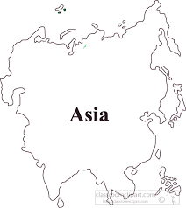
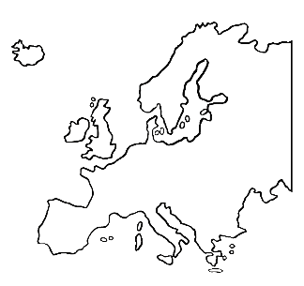
FALSE: NEITHER ARE NATIVE
JUMPING WORMS COME FROM EAST ASIA
EARTHWORMS CAME FROM EUROPE
All native earthworms in North America died in the last glacier period 10,000 years ago

Slide 7

A QUIZ TRUE OR FALSE:
JUMPING WORMS ARE SMALLER THAN EARTHWORMS

Slide 8
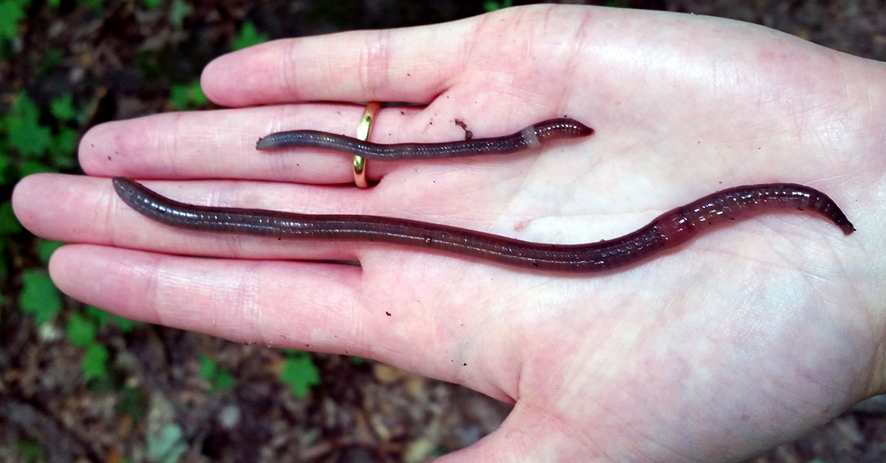
TRUE
ADULT JUMPING WORMS are SMALLER than EARTHWORMS
  5-8 inches in length vs. up to 14 inches in length
  Jumping Worms are not as big in diameter as Earthworms

Slide 9

A QUIZ TRUE OR FALSE:
JUMPING WORMS ARE NOT EARTHWORMS

Slide 10
FALSE
JUMPING WORMS ARE EARTH WORMS
ALL EARTHWORMS HAVE A CLITELLUM
Clitellums are part of the reproductive system which
produces eggs and stores them in cocoons

Slide 11
In the EARTHWORM:
The clitellum has a thickened band of tissue found in the epidermis that does not completely encircle the earthworm’s body. It is about ½ down the body from the head
In the JUMPING WORM:
The clitellum is a milky white color that wraps entirely around the worm close to the head. It can look swollen when filled with eggs.

Slide 12
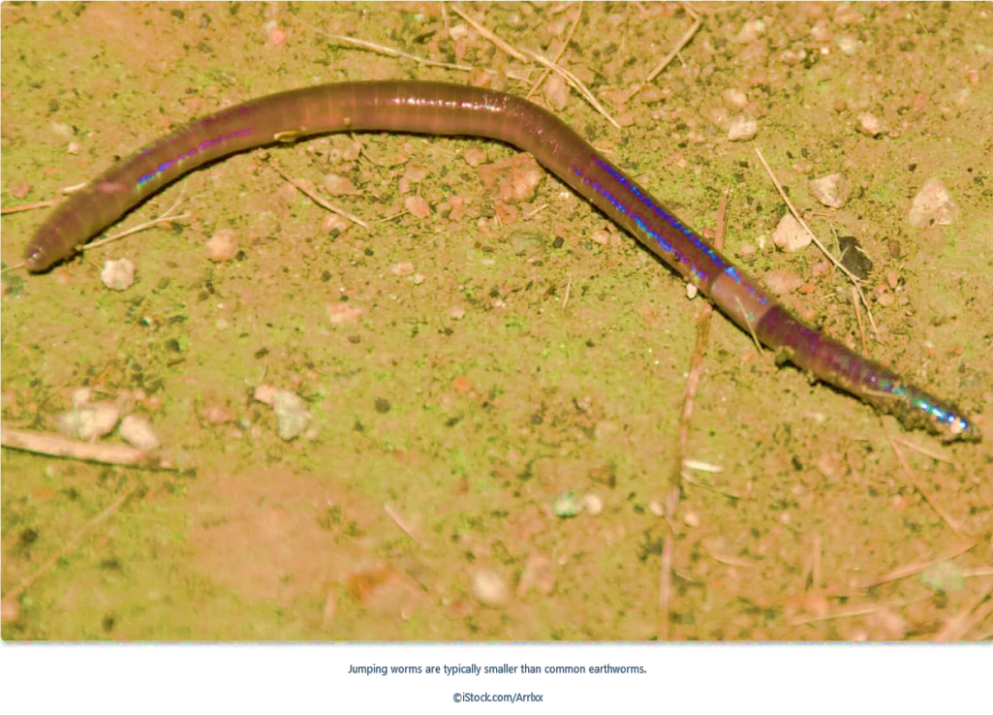
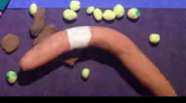
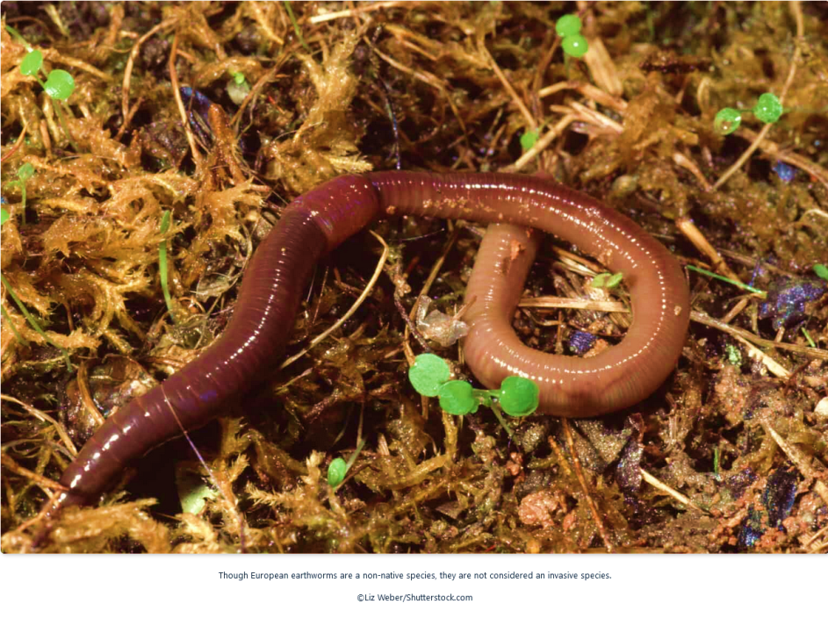
JUMPING WORM Clitellum where eggs are located (cocoons)
EARTH WORM Clitellum

Slide 13
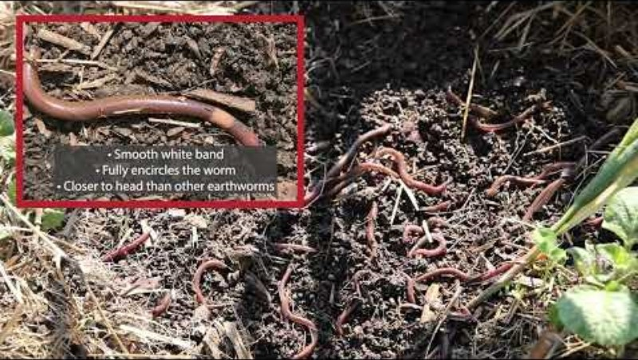
University of MAINE, Cooperative Forestry Research Unit:
Identify and Report Invasive Worms
https://www.youtube.com/watch?v=ExMVwN-se1g

Slide 14
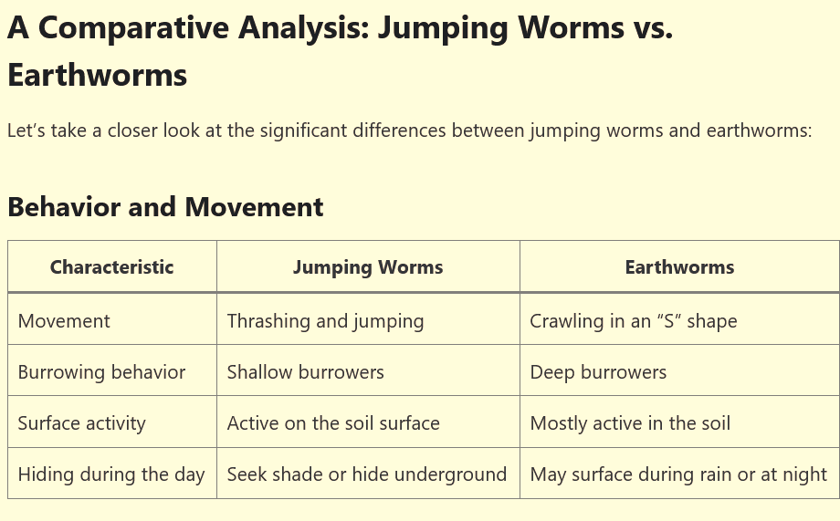
OTHER WAYS TO IDENTIFY JUMPING WORMS

Slide 15
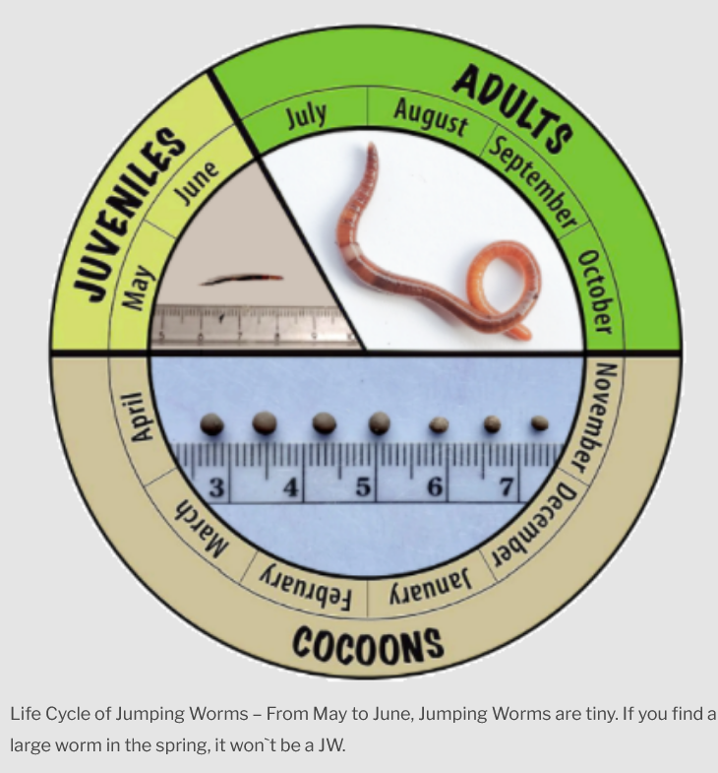
KNOW THE LIFE CYCLE OF THE JUMPING WORM
May-August, juveniles
grow to adults in 60 days
August – September: Worms reproduce leaving cocoons containing eggs in landscapes and forests
Juvenile worms are
.5- 2 inches long.
They do not have
a Clitellum
September-October
Most worms visible
April and May
Cocoons begin
To hatch
When the temp
is 50 F
The First Frost kills the
Worms but the cocoons
live through the winter
JWs-information-Dealing-with-infestations-in-your-garden.pdf

Slide 16
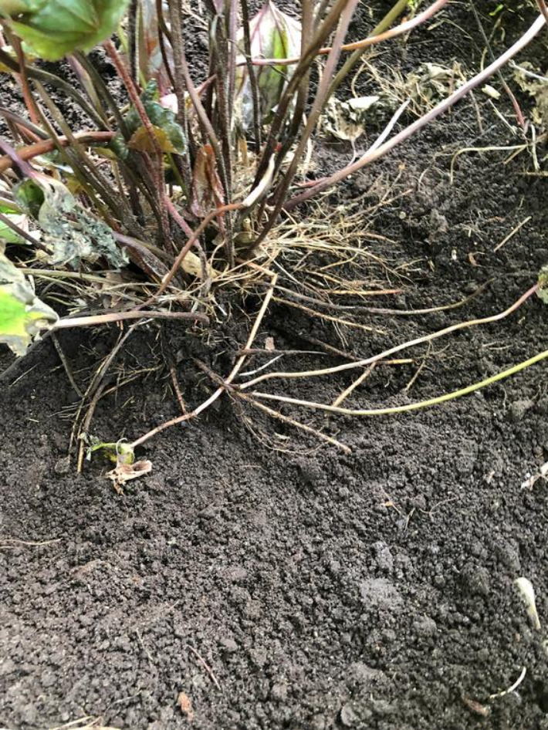
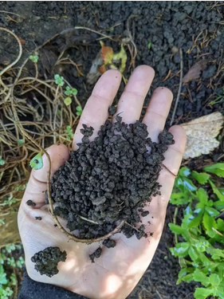
HOW JUMPING WORMS DESTROY THE SOIL
JUMPING WORMS feed in large groups,
devouring the organic matter found in top 2-3 inches of soil including leaf litter, decomposing plant material and other soil organisms.
They alter soil
structure
and nutrient
availability leaving
soil that looks like
coffee grounds
https://wormsurvey.org/jumping-worms-vs-earthworms/

Slide 17
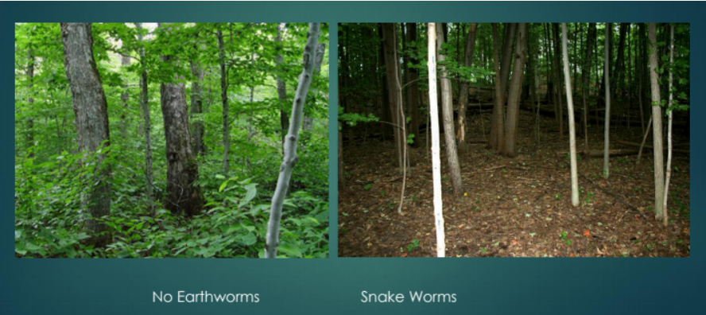
DAMAGE TO FORESTS: NO UNDERSTORY, SOIL STRUCTURE CAN NOT HOLD PLANTS
No Jumping Worms
Jumping Worms
LEAF LITTER needed for NATIVE PLANTS AND INSECTS is CONSUMED.
https://vtinvasives.org/invasive/jumping-worms

Slide 18
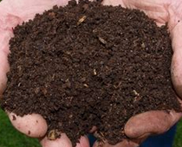
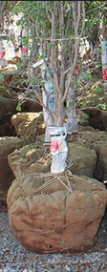
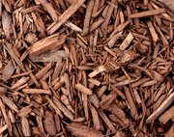
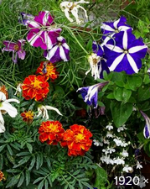
HOW JUMPING WORMS SPREAD
COMPOST LOAM
MANURE
MULCH
POTTING MIXES
POTTED PLANTS
BALLED AND BURLAP TREES AND SHRUBS
BY WORMS OR COCOONS.

Slide 19

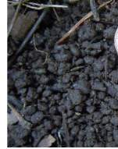
HOW DO I TELL IF I HAVE JW?
MONITOR your property for jumping worms
  Look for coffee-ground-like soil.
MIX 1/3 CUP GROUND YELLOW MUSTARD SEED with
1 GALLON OF WATER
Clear a patch of soil and pour the solution slowly over it.
The worms become irritated and will come to the surface.
Gather the worms up and place in a Ziploc plastic bag in the sun for at least 10 minutes.
DETECT COCOONS by shoveling soil into a pail filled with water. The cocoons will float to the surface.

Slide 20

PREVENTION
CLEAN Boots or shoe treads, gardening tool, vehicles, ATV wheels
to avoid transmission of cocoons.
Brush off dirt. Soak tools in Soap and water. Sanitize with 2 tsp Clorox in 1 gallon H2O. Let tools soak for 10 minutes. Dry thoroughly.
Use different tools to dig up & pot plants.
Sterilize pots in Bleach for 10 minutes
Avoid purchasing jumping worms for bait
After potting, DO NOT store pots on gardens or lawns where they can pick up eggs or worms. Place on tarp, shelves, deck, etc.
Propagate via seeds and stem cuttings whenever possible (rather than plant division or root cuttings)

Slide 21

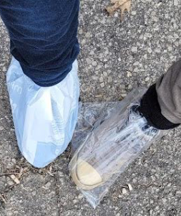
STOP THE SPREAD
Think Out of the Box
Cover feet with PLASTIC BAGS, using TAPE at the ankle to keep them on while in the garden. Bags should be
turned inside out after wearing and disposed of in the garbage.
TALK WITH YOUR LANDSCAPERS and NURSURIES.
What are they doing about Jumping Worms?
REMEMBER: Raking or blowing leaves can move
and concentrate egg sacks (cocoons)

Slide 22

MORE……
PLANTING TIME
AVOID PLANTING in summer when Jumping Worm are most plentiful
PLANT IN SPRING before Jumping Worms Mature.
PLANT TREES IN FALL to allow to establish when Jumping Worm populations start to decline
Water WELL
Plant NATIVE SPECIES that are drought tolerant and have deeper roots. Native grasses, groundcovers and other perennials
thickly planted, showed some signs of success in invaded soils.
If plants are not doing well, inspect the roots and remove
& destroy any Jumping Worms and cocoons.
JWs-information-Dealing-with-infestations-in-your-garden.pdf

Slide 23


WHEN YOU FIND JUMPING WORMS
COLLECT & PUT THEM IN A ZIPLOC Bag & leave in the sun
for 10 minutes to kill them or drown in soapy water.
Seal bags & dispose of worms in the trash
DO NOT put in your compost.
How to Kill the worms and the egg cocoons.
Place a plastic or a tarp under your soil, manure or mulch with plenty of uncovered plastic on the outer edges, in a SUNNY LOCATION
Cover with clear plastic (1.5 to 2 mils thick)* This is called Solarization
Tack the plastic down tightly so that the worms cannot get in or out
Leave for 2-3 week or until the
Temperature is 105⁰ or higher For THREE DAYS in Spring or Summer
* rolls of 1 to 4 mil "painter's" plastic are available at larger hardware stores. These should last for the solarization period without breaking down.

Slide 24
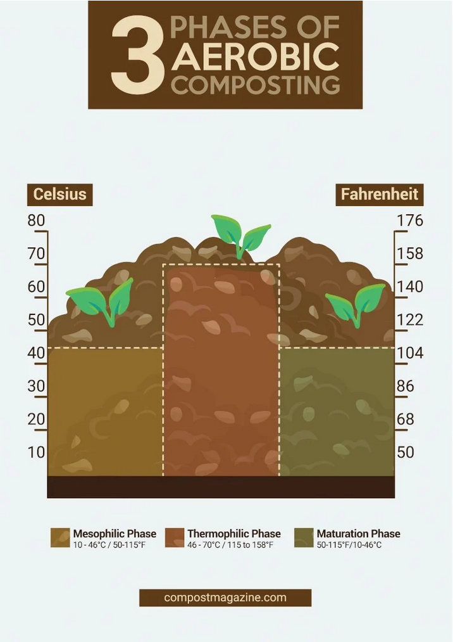
LOOK FOR A COMPOST/POTTING SOURCE SUPPLIER
that follows the “process for further
reducing pathogens” in
preparing compost, potting soil
The compost/soil should reach
temperatures between 104-151°
The piles should be turned on a regular
Schedule.
THIS PROCESS: is most likely to
KILL JUMPING WORMS
AND THEIR EGGS

Slide 25
BEWARE
Composting materials above 105 degrees F can kill worms and their cocoons.
BUT, IF THE HEATED MATERIALS ARE STORED AFTER COOLING IN AN UNPROTECTED SPACE,
these previously heated materials can also be re-infested by jumping worms if they are not stored in a protective container.

Slide 26

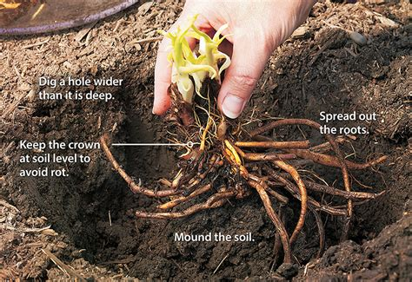
WGC GUIDELINES for PLANT SALE TO CONTROL
THE SPREAD OF JUMPING WORMS
The Plant Sale is our biggest source of income & supports our
programs. We must ensure we are not responsible for spreading
these worms through careless practices.
If you know you have jumping worms, PLEASE DO NOT donate plants from that
garden unless you have removed all soil, inspected the plant and repot in sterilized
soil.
THE BEST PRACTICE IS TO REMOVE ALL GARDEN SOIL (WASH IN WATER) & INSPECT PLANTS.
WASH in a bucket of water to remove cocoons
RINSE in second bucket of water until you think the cocoons are removed.
BARE ROOT PLANTS ARE SAFEST
PUT INTO PLASTIC OR PAPER BAGS TO SELL SELL.

Slide 27
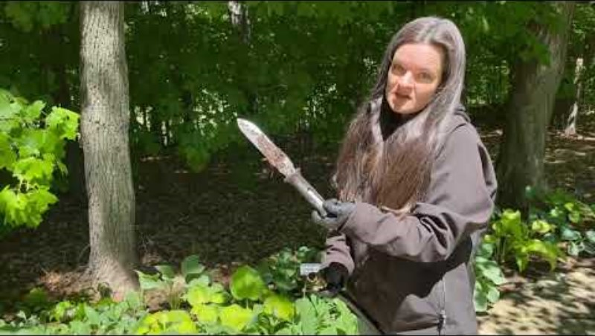

VIDEO ON CLEANING PLANTS, Univ. Minnesota

Slide 28
REPORT JUMPING WORMS
Report any sightings to EDDMapS (EDDMaps.org) or
to iNaturalist (iNaturalist.org).
Both of these on-line resources have phone apps as well, and both are checked by state employees concerned with invasive species. It is important to include numbers observed and area impacted in your report with PICTURES
You can also report them To the MA Department of Agricultural Resources https://massnrc.org/pests/report.aspx
REPORTING IS CRITICAL in that it provides data to scientists and visibility of the problem. Don’t assume someone else has made a report.

Slide 29

INVASIVE INSECTS
SPOTTED LANTERNFLY
EMERALD ASH BORER
LONGHORNED BEETLE
HEMLOCK WOOLLY ADELGID

Slide 30

Special Thanks to Kaitlin Kohnberger, author, and The Princeton
EAC News Brief for sharing this document with us.
https://drive.google.com/file/d/17mnVH8e1npsqx7-RiotgCScUK5PM1w0H/view
Look Out! Invasive Insects!
Spotted Lanternfly (Ailanthus altissima): You’ve likely heard of this invasive insect, which was confirmed in the United States in 2014. It attacks a variety of trees, shrubs, and vines, and causes damage to trees by feeding on their sap. It has the potential to become a serious agricultural pest.
Adults are distinctive looking, with a mixture of stripes and spots on their front wings. Their back wings have a bright red color that contrasts white the white, black, and tan coloration of the rest of the body.
If you come across a Spotted Lanternfly, snap a picture and report it to the state here: https://massnrc.org/pests/slfreport.aspx

Slide 31
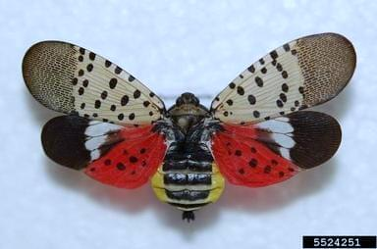
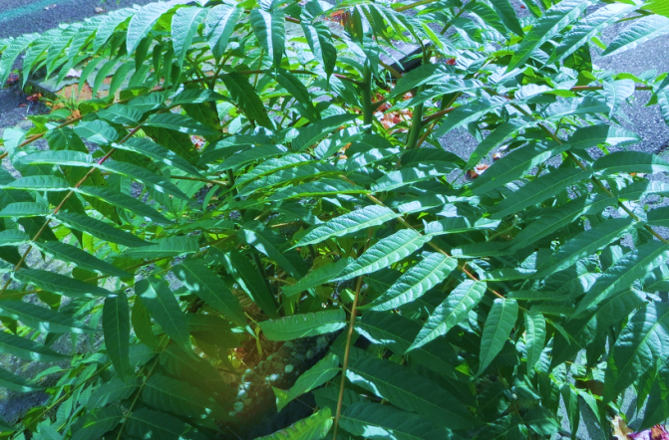
An Insect (Spotted Lanternfly) and it’s Host Plant (Tree of Heaven)
Photo: Andreas Rockstein CC-BY-SA 2.0
Spotted Lanternfly (Lycorma delicatula) is
indigenous to China and Vietnam. It first
came to the US in 2014. It is a plant hopper
and feeds on woody and ornamental trees as well as crops and plants.
Crops affected included soybeans, grapes, stone fruits (peaches, plus, dates, mangos, coconuts, olives and the apple family).
In its native habitat, L. delicatula populations
are regulated by parasitic wasps.
The Tree of Heaven (Ailanthus altissima) is native to China and brought to the US 1784. It is very invasive and is considered to be the host for L. delicatula , playing a key role in the lanternfly life cycle.
Deciduous Tree
Yellow Flowers: June to July
Winged Fruits: Fall dispersed by wind
or water (samaras)
Leaves: Compound, unpleasant
when odor when crushed.
https://en.wikipedia.org/wiki/Ailanthus_altissiman
https://www.conservect.org/wp-content/uploads/2018/01/Invasives_guide_2016_web.pdf

Slide 32
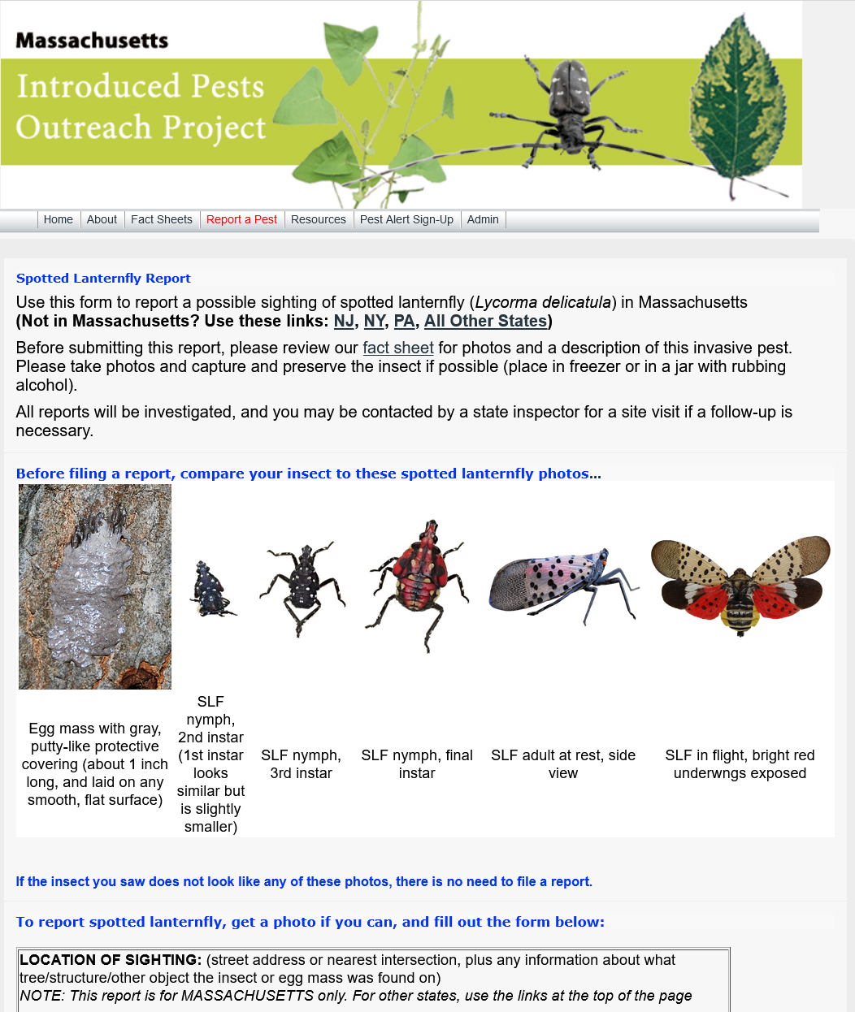
NOTE: If you come across a Spotted Lanternfly, take a picture and report it to the state here:
https://massnrc.org/pests/slfreport.aspx

Slide 33
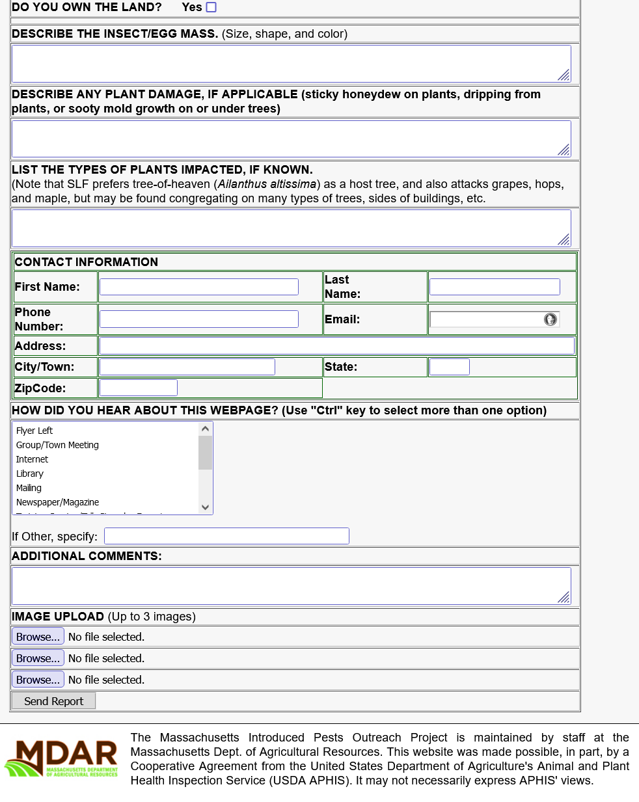
Page 2 of Reporting Form
Spotted Lanternfly

Slide 34
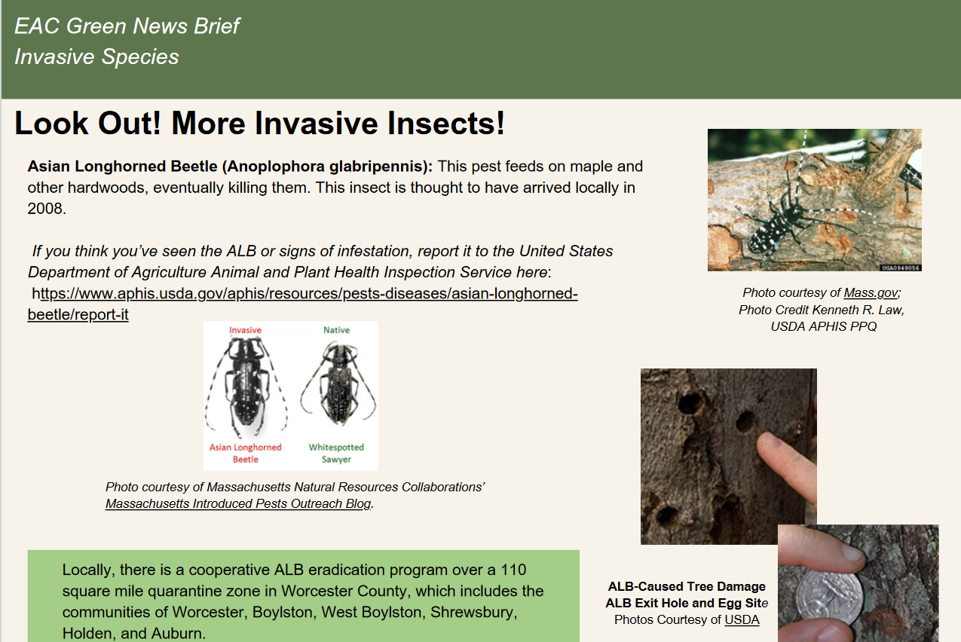
https://drive.google.com/file/d/17mnVH8e1npsqx7-RiotgCScUK5PM1w0H/view

Slide 35
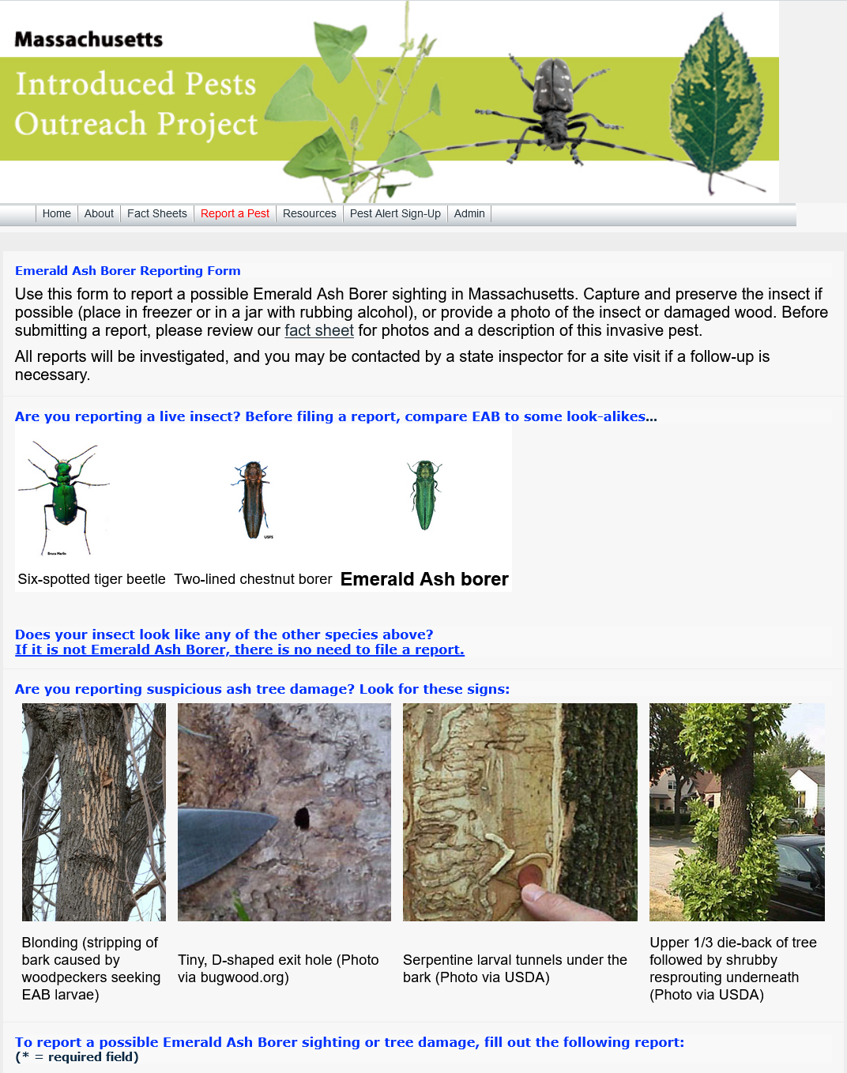
NOTE: Report a possible EAB siting here: https://massnrc.org/pests/eabreport.htm

Slide 36
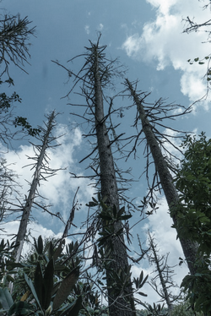
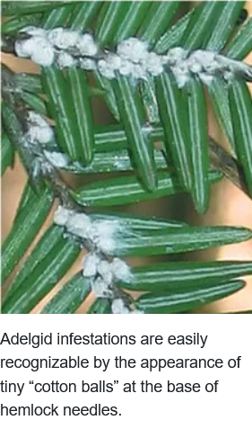
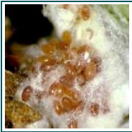
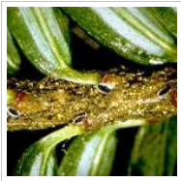
Hemlock Woolly Adelgid
Text and images licensed Creative Common
Attribution 3.0.
https://www.wncoutdoors.info/dead-hemlocks-at-linville-falls/
eggs
nymphs
The hemlock woolly adelgid (HWA; Adelges tsugae) is a tiny invasive insect species related to aphids, introduced to the eastern United States in the 1950's. Native to Japan, the hemlock woolly adelgid was first detected in Massachusetts in 1988.
There are no known biological controls for adelgid but chemical treatments (oils & insecticidal soaps) can be effective in slowing down the stressing of the trees.
https://www.nps.gov/grsm/learn/nature/hemlock-woolly-adelgid.htm photo 1

Slide 37
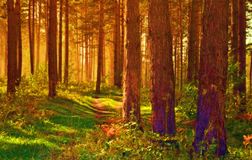
PROTECT OUR FORESTS
CONTROL of INVASIVES
Inspect your trees to look for egg masses on the trunks. Scrap off as much as possible & dispose of in the trash.
Look for holes in trunks and signs of tree stress.
DO NOT collect wood from areas known to have any of these invasives.
If you are in an area known to have invasives like Long Horned Beetle, do not take wood out of the area. Cut wood needs to ground up.
Diversify your tree species so an infestation of one species doesn’t impact all of your trees. PLANT NATIVE!!!

Slide 38

ONCE INVASIVE SPECIES HAVE TAKEN HOLD,
THEY ARE VERY HARD TO ELIMINATE
PREVENTION IS KEY
LEARN TO RECOGNIZE INVASIVES WHEN THEY ARE SMALL
AND EASIER TO REMOVE
TEACH OTHERS ABOUT INVASIVE SPECIES, WHAT TO LOOK FOR AND HOW TO GET MORE INFORMATION

Slide 39

MONTHLY UPDATE: https://massnrc.org/pests/blog/
SEE WACHUSETT GARDEN CLUB WEBSITE
FOR MORE INFORMATION
https://www.wachusettgardenclub.org/invasive-plant-info.html

Slide 40
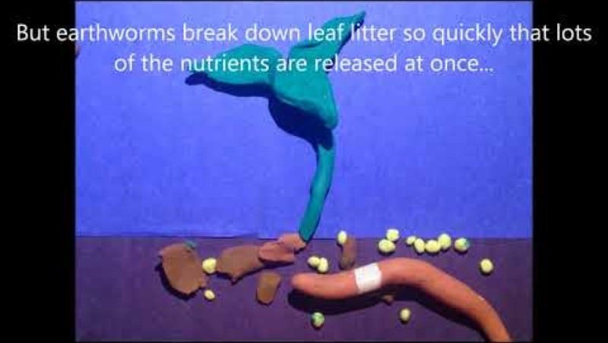
Invasive Jumping Worms - Claymation

Slide 41
THANK YOU!!

